Slide 1



LIFE/work balance
We have started a #LIFEworkbalance campaign and we need your help to complete our LIFE/work balance survey.
We hope to publish the results soon, so please give 15 minutes of your time to help us get a true picture of school life.
Want to be a part of this campaign? Take the survey on our website and share it with your colleagues!
© Classroom Secrets Limited 2019

Slide 2

Year 6 – Summer Block 3 – Statistics – Read and Interpret Pie Charts
About This Resource:
This PowerPoint has been designed to support your teaching of this small step. It includes a starter activity and an example of each question from the Varied Fluency and Reasoning and Problem Solving resources also provided in this pack. You can choose to work through all examples provided or a selection of them depending on the needs of your class.
National Curriculum Objectives:
Mathematics Year 6: (6S1) Interpret and construct pie charts and line graphs and use these to solve problems
More Year 6 Statistics resources.
Did you like this resource? Don’t forget to review it on our website.
© Classroom Secrets Limited 2018

Slide 3
Year 6 – Summer Block 3 – Statistics
Step 5: Read and Interpret Pie Charts
© Classroom Secrets Limited 2018

Slide 4

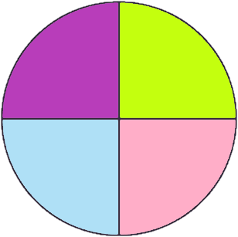
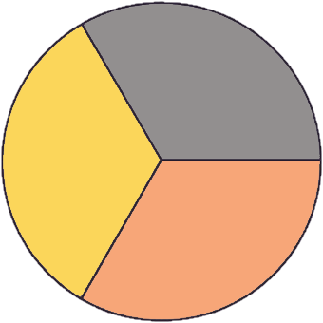
Introduction
Interpret these simple pie charts.
 | walk
 | bus
 | car
 | bike
 | dog
 | cat
 | rabbit
 | girls
 | boys
If a class had 34 children in it, how many would be boys?
60 children were asked how they got to school. How many children travelled by car?
120 children were asked to choose
a favourite pet. How many children chose a rabbit?
© Classroom Secrets Limited 2018

Slide 5
Introduction
Interpret these simple pie charts.
 | walk
 | bus
 | car
 | bike
 | dog
 | cat
 | rabbit
 | girls
 | boys
If a class had 34 children in it, how many would be boys?
17
60 children were asked how they got to school. How many children travelled by car?
15
120 children were asked to choose
a favourite pet. How many children chose a rabbit?
40
© Classroom Secrets Limited 2018

Slide 6
Varied Fluency 1
What fraction of the pie chart represents
people who chose dolphins?
Favourite Animal
© Classroom Secrets Limited 2018

Slide 7
Varied Fluency 1
What fraction of the pie chart represents
people who chose dolphins?
Favourite Animal
1
8
© Classroom Secrets Limited 2018

Slide 8
Varied Fluency 2
The pie chart shows the votes of 360 people.
How many chose toast?
Favourite Breakfast
© Classroom Secrets Limited 2018

Slide 9
Varied Fluency 2
The pie chart shows the votes of 360 people.
How many chose toast?
Favourite Breakfast
120
© Classroom Secrets Limited 2018

Slide 10
Varied Fluency 3
500 people took part in a survey about sport.
How many people does each segment represent?
Favourite Sport
© Classroom Secrets Limited 2018

Slide 11
Varied Fluency 3
500 people took part in a survey about sport.
How many people does each segment represent?
Favourite Sport
100
200
100
100
© Classroom Secrets Limited 2018

Slide 12
Varied Fluency 4
How many people from the 480 surveyed chose each option?
Favourite Meal
© Classroom Secrets Limited 2018

Slide 13
Varied Fluency 4
How many people from the 480 surveyed chose each option?
Favourite Meal
120
60
300
© Classroom Secrets Limited 2018

Slide 14
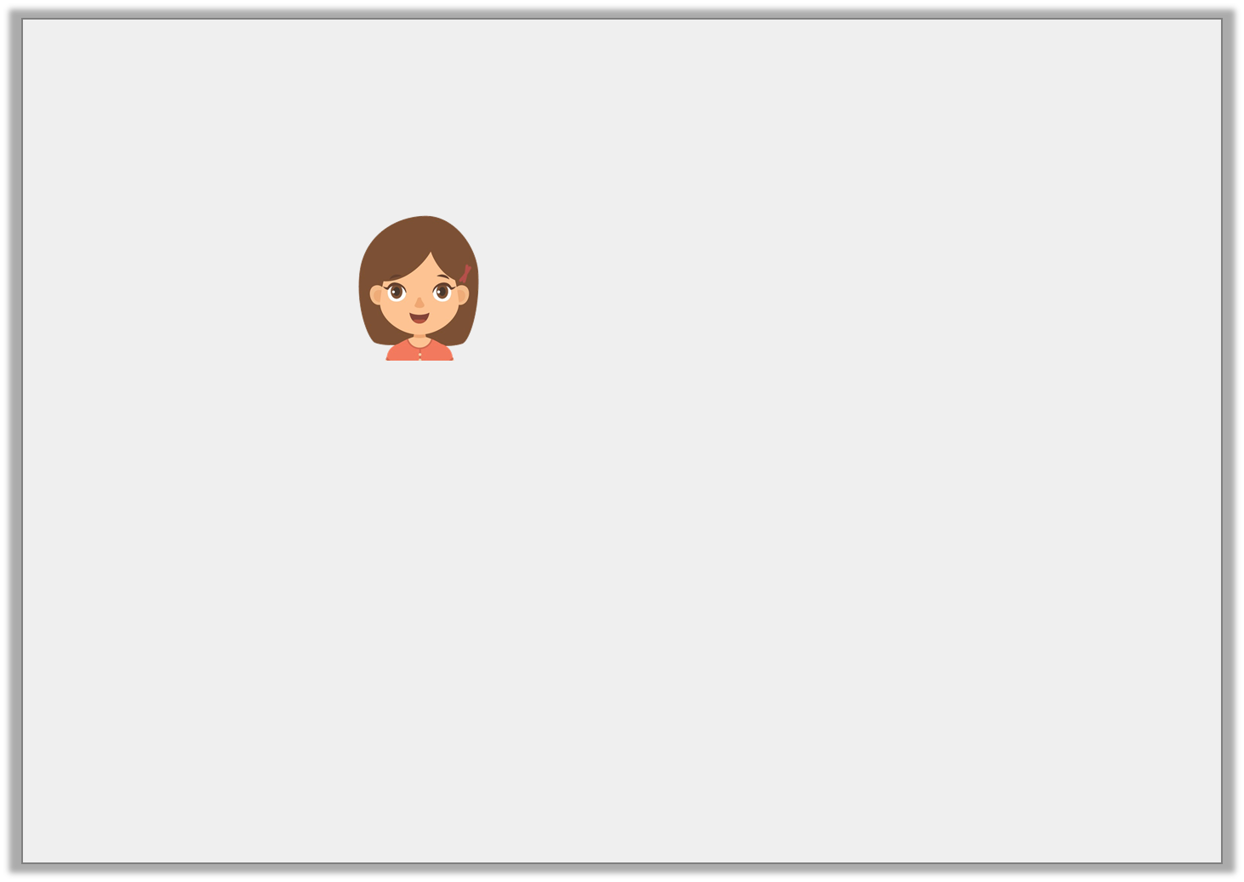
Reasoning 1
Nancy says,
Is she correct? Prove it.
I do not have enough information to work out
the total number of votes.
110
110
Favourite Snack
© Classroom Secrets Limited 2018

Slide 15
Reasoning 1
Nancy says,
Is she correct? Prove it.
Nancy is not correct because…
I do not have enough information to work out
the total number of votes.
110
110
Favourite Snack
© Classroom Secrets Limited 2018

Slide 16
Reasoning 1
Nancy says,
Is she correct? Prove it.
Nancy is not correct because 110 people represent one sixth of the voters so 660 people must have voted altogether.
I do not have enough information to work out
the total number of votes.
110
110
Favourite Snack
© Classroom Secrets Limited 2018

Slide 17
Problem Solving 1
Dante has forgotten what fraction of the pie chart should be given
to ‘Blue’. Work out the fraction from the information below.
Favourite Colour
Red | 100 people
Green | 50 people
Pink | 100 people
Blue | ?
Total | 400 people
© Classroom Secrets Limited 2018

Slide 18
Problem Solving 1
Dante has forgotten what fraction of the pie chart should be given
to ‘Blue’. Work out the fraction from the information below.
Favourite Colour
Red | 100 people
Green | 50 people
Pink | 100 people
Blue | 150 people
Total | 400 people
3
8
© Classroom Secrets Limited 2018

Slide 19
Reasoning 2
Imagine a pie chart with the same proportions as the
one below was drawn for a survey of 600 people.
Would the ‘Scooter’ category have 100 people in it? Convince me.
How children
get to school
(450 people)
© Classroom Secrets Limited 2018

Slide 20
Reasoning 2
Imagine a pie chart with the same proportions as the
one below was drawn for a survey of 600 people.
Would the ‘Scooter’ category have 100 people in it? Convince me.
No because…
How children
get to school
(450 people)
© Classroom Secrets Limited 2018

Slide 21
Reasoning 2
Imagine a pie chart with the same proportions as the
one below was drawn for a survey of 600 people.
Would the ‘Scooter’ category have 100 people in it? Convince me.
No because the ‘Scooter’ category in the chart of 450 people was selected 90 times. 90 out of 450 is one fifth. One fifth of 600 is 120, not 100.
How children
get to school
(450 people)
© Classroom Secrets Limited 2018

