Slide 1
THE ISLAND OF CAYUNA
By parmoor

Slide 2
About the island
The island is a warm climate island and it has a rainforest in it
Everyone on the island is Gentle, Kind and have a strong opinion on equality.

Slide 3
FLAGS
Mr Honey showed us a video of different flags and everyone tried to guess which country they belong to
He also told us that different symbols mean different things like doves mean peace
Our first task was to create our own flag and had to explain what they mean

Slide 4
Flag Quiz
We will now show 4 pictures of different countries flags guess who they belong to raise your hand if you know who the flag belongs to

Slide 5
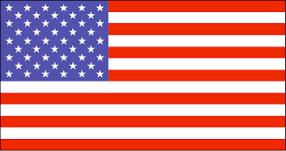

Slide 6
AMERICA

Slide 7
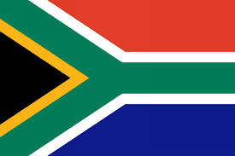

Slide 8
SOUTH AFRICA

Slide 9
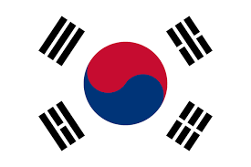

Slide 10
SOUTH KOREA

Slide 12
CANADA

Slide 13
KS1

Slide 14
KS1
Key Stage 1 made flags colouring in with the primary colours yellow, blue and red.
After they had made their flag they made animals that could live in a rainforest here are some pictures

Slide 15
