Slide 1
LIFE/work balance
We have started a #LIFEworkbalance campaign and we need your help to complete our LIFE/work balance survey.
We hope to publish the results soon, so please give 15 minutes of your time to help us get a true picture of school life.
Want to be a part of this campaign? Take the survey on our website and share it with your colleagues!
© Classroom Secrets Limited 2019

Slide 2
Year 6 – Summer Block 3 – Statistics – Pie Charts with Percentages
About This Resource:
This PowerPoint has been designed to support your teaching of this small step. It includes a starter activity and an example of each question from the Varied Fluency and Reasoning and Problem Solving resources also provided in this pack. You can choose to work through all examples provided or a selection of them depending on the needs of your class.
National Curriculum Objectives:
Mathematics Year 6: (6S1) Interpret and construct pie charts and line graphs and use these to solve problems
More Year 6 Statistics resources.
Did you like this resource? Don’t forget to review it on our website.
© Classroom Secrets Limited 2018

Slide 3
Year 6 – Summer Block 3 – Statistics
Step 6: Pie Charts with Percentages
© Classroom Secrets Limited 2018

Slide 4
Introduction
Calculate these percentages of quantities.
Find 25% of:
60 | 84 | 56 | 168
Find 10% of:
70 | 150 | 690 | 125
Find 5% of:
20 | 140 | 280 | 360
© Classroom Secrets Limited 2018

Slide 5
Introduction
Calculate these percentages of quantities.
Find 25% of:
60 15 | 84 21 | 56 14 | 168 42
Find 10% of:
70 7 | 150 15 | 690 69 | 125 12.5
Find 5% of:
20 1 | 140 7 | 280 14 | 360 18
© Classroom Secrets Limited 2018

Slide 6
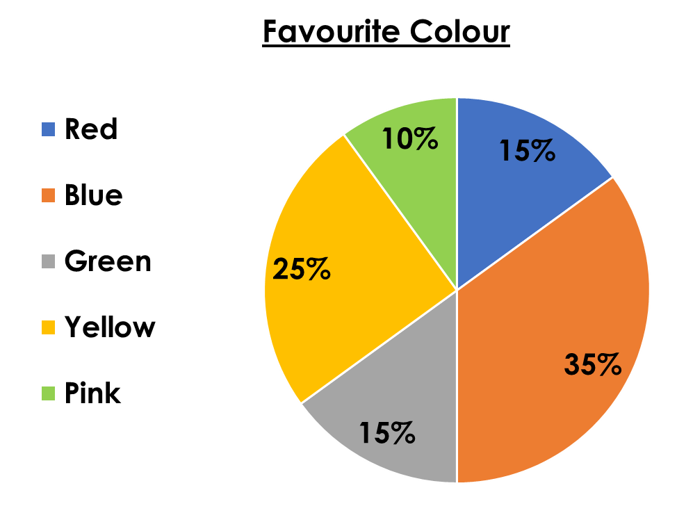
Varied Fluency 1
60 children voted for their favourite colour.
Here are the results:
How many voted for red?
© Classroom Secrets Limited 2018

Slide 7
Varied Fluency 1
60 children voted for their favourite colour.
Here are the results:
How many voted for red?
9
© Classroom Secrets Limited 2018

Slide 8
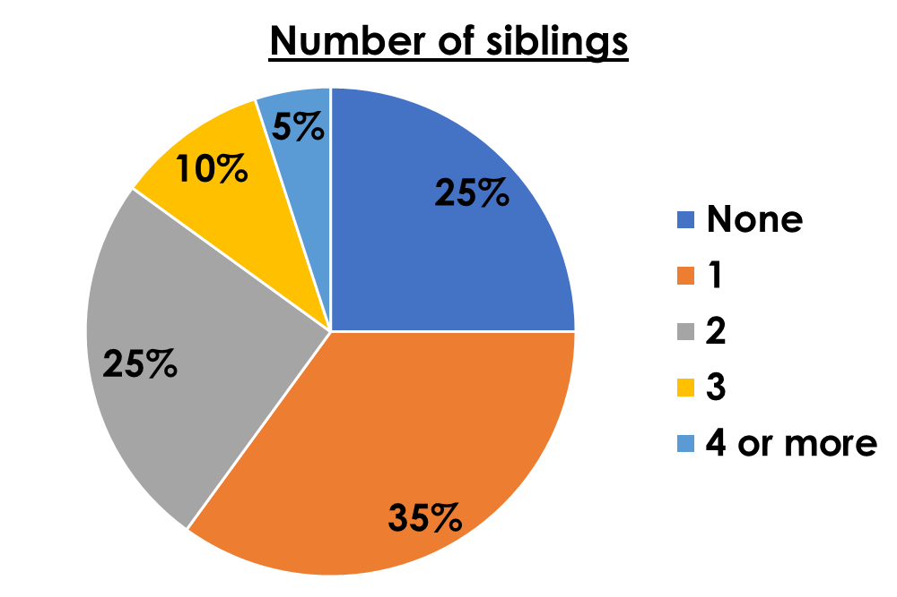
Varied Fluency 2
200 children were asked how many siblings they have.
Here are the results:
How many more children have two siblings than three?
© Classroom Secrets Limited 2018

Slide 9
Varied Fluency 2
200 children were asked how many siblings they have.
Here are the results:
How many more children have two siblings than three?
30
© Classroom Secrets Limited 2018

Slide 10
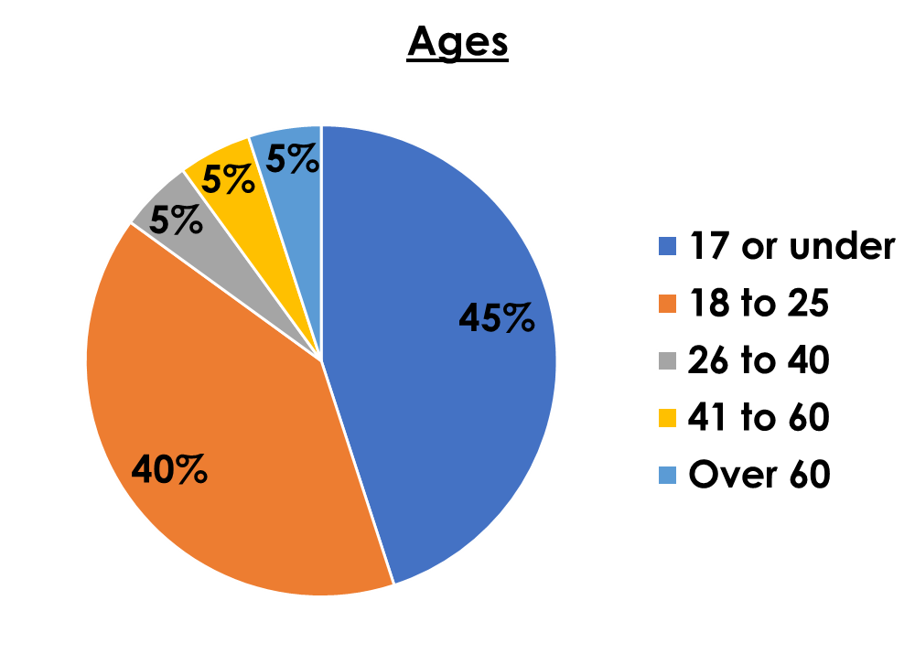
Varied Fluency 3
120 people were asked their age.
Here are the results:
How many were in each age bracket?
© Classroom Secrets Limited 2018

Slide 11
Varied Fluency 3
120 people were asked their age.
Here are the results:
How many were in each age bracket?
17 or under – 54, 18 to 25 – 48, 26 to 40 – 6, 41 to 60 – 6, Over 60 – 6
© Classroom Secrets Limited 2018

Slide 12
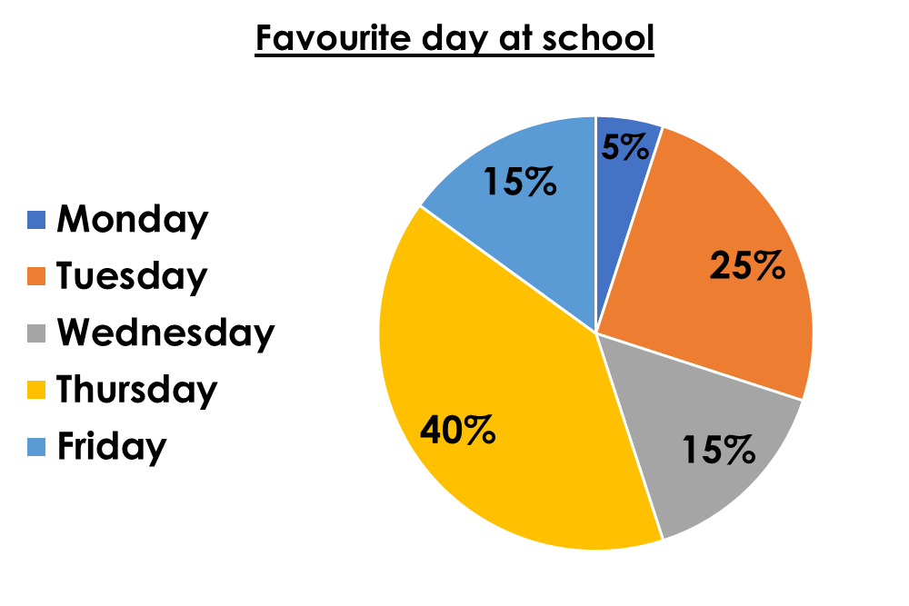
Varied Fluency 4
If 30 people chose Friday, how many chose Thursday?
© Classroom Secrets Limited 2018

Slide 13
Varied Fluency 4
If 30 people chose Friday, how many chose Thursday?
80
© Classroom Secrets Limited 2018

Slide 14
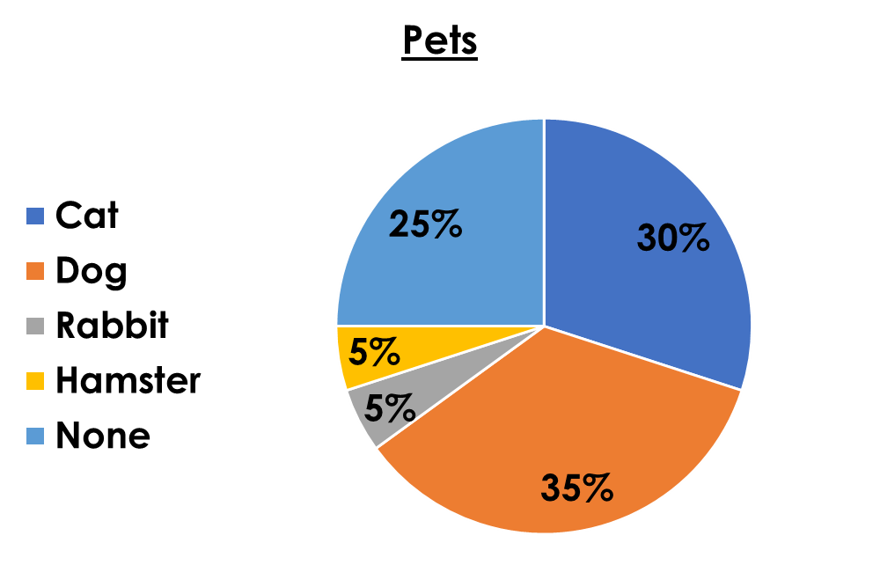
Problem Solving 1
Children were asked what pets they have. This was the result:
10 children have a hamster.
Use this information to help you convert the pie chart into a table.
© Classroom Secrets Limited 2018

Slide 15
Problem Solving 1
Children were asked what pets they have. This was the result:
10 children have a hamster.
Use this information to help you convert the pie chart into a table.
Cat | 60
Dog | 70
Rabbit | 10
Hamster | 10
None | 50
© Classroom Secrets Limited 2018

Slide 16
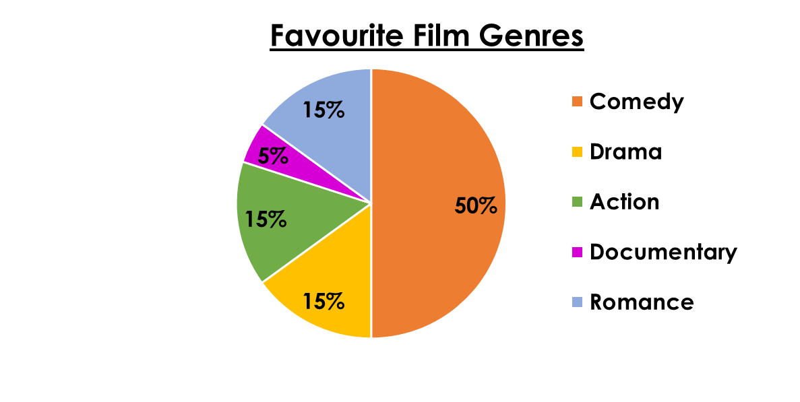
Reasoning 1
Lisa is reading a pie chart about the favourite
film genres of 60 children.
She says,
Is she right? Explain how you know.
The same people chose drama, action and romance.
Lisa
© Classroom Secrets Limited 2018

Slide 17
Reasoning 1
Lisa is reading a pie chart about the favourite
film genres of 60 children.
She says,
Is she right? Explain how you know. Lisa is not correct because…
The same people chose drama, action and romance.
Lisa
© Classroom Secrets Limited 2018

Slide 18
Reasoning 1
Lisa is reading a pie chart about the favourite
film genres of 60 children.
She says,
Is she right? Explain how you know. Lisa is not correct because the pie chart tells us the number of different people who voted for their favourite film genres. The numbers are the same, not the people.
The same people chose drama, action and romance.
Lisa
© Classroom Secrets Limited 2018

Slide 19
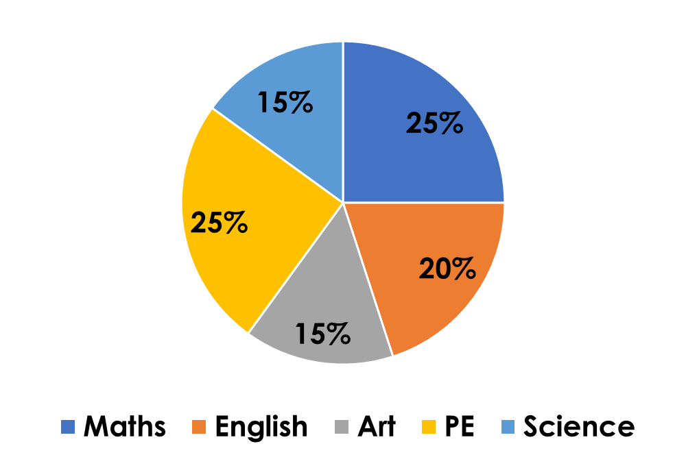
Reasoning 2
What information can you get from this pie chart?
What does it not tell you?
© Classroom Secrets Limited 2018

Slide 20
Reasoning 2
What information can you get from this pie chart?
What does it not tell you?
You can tell that…
You cannot tell…
© Classroom Secrets Limited 2018

Slide 21
Reasoning 2
What information can you get from this pie chart?
What does it not tell you?
You can tell that the same amount of people chose art and science.
You cannot tell how many chose any subject because the chart doesn’t give any information on how many people were asked.
© Classroom Secrets Limited 2018

