Slide 1
LIFE/work balance
We have started a #LIFEworkbalance campaign and we need your help to complete our LIFE/work balance survey.
We hope to publish the results soon, so please give 15 minutes of your time to help us get a true picture of school life.
Want to be a part of this campaign? Take the survey on our website and share it with your colleagues!
© Classroom Secrets Limited 2019

Slide 2
Year 6 – Summer Block 3 – Statistics – The Mean
About This Resource:
This PowerPoint has been designed to support your teaching of this small step. It includes a starter activity and an example of each question from the Varied Fluency and Reasoning and Problem Solving resources also provided in this pack. You can choose to work through all examples provided or a selection of them depending on the needs of your class.
National Curriculum Objectives:
Mathematics Year 6: (6S3) Calculate and interpret the mean as an average
More Year 6 Statistics resources.
Did you like this resource? Don’t forget to review it on our website.
© Classroom Secrets Limited 2018

Slide 3
Year 6 – Summer Block 3 – Statistics
Step 8: The Mean
© Classroom Secrets Limited 2018

Slide 4
Introduction
Complete the additions below.
Complete the divisions below.
 | 7
1 | ?
 | 6
 | 4
? | 8
1 | 6
? | 3
3 | 5
2 | 5
9 | ?
1 | ? | . | 2
2 | 1 | . | 6
 | 5 | . | 1
3 | 4 | . | 3
? | 2 | . | ?
9 | 8 |  | ÷ |  | ? |  | = |  | 1 | 4
3 | 6 |  | ÷ |  | 8 |  | = |  | 4 | . | ?
? | 6 |  | ÷ |  | 8 |  | = |  | 9 | . | 5
6 | 3 |  | ÷ |  | ? |  | = |  | 7
© Classroom Secrets Limited 2018

Slide 5
Introduction
Complete the additions below.
Complete the divisions below.
 | 7
1 | 1
 | 6
 | 4
2 | 8
1 | 6
2 | 3
3 | 5
2 | 5
9 | 9
1 | 1 | . | 2
2 | 1 | . | 6
 | 5 | . | 1
3 | 4 | . | 3
7 | 2 | . | 2
9 | 8 |  | ÷ |  | 7 |  | = |  | 1 | 4
3 | 6 |  | ÷ |  | 8 |  | = |  | 4 | . | 5
7 | 6 |  | ÷ |  | 8 |  | = |  | 9 | . | 5
6 | 3 |  | ÷ |  | 9 |  | = |  | 7
© Classroom Secrets Limited 2018

Slide 6
Varied Fluency 1
Calculate the mean of these numbers.
 | 77 |  |  | 14
 | 58 |  |  | 9
 | 13 |  |  | 21
© Classroom Secrets Limited 2018

Slide 7
Varied Fluency 1
Calculate the mean of these numbers.
(77 + 14 + 58 + 9 + 13 + 21) ÷ 6 = 32
 | 77 |  |  | 14
 | 58 |  |  | 9
 | 13 |  |  | 21
© Classroom Secrets Limited 2018

Slide 8
Varied Fluency 2
Which is the correct mean of these children’s house points.
17 | 19 | 21 | 15 | 13
16
17
18
© Classroom Secrets Limited 2018

Slide 9
Varied Fluency 2
Which is the correct mean of these children’s house points.
17 | 19 | 21 | 15 | 13
16
17
18
© Classroom Secrets Limited 2018

Slide 10
Varied Fluency 3
True or false?
The mean of these numbers is 19.
6
11
17
24
9
53
© Classroom Secrets Limited 2018

Slide 11
Varied Fluency 3
True or false?
The mean of these numbers is 19.
False
(6 + 11 + 17 + 24 + 9 + 53) ÷ 6 = 20
6
11
17
24
9
53
© Classroom Secrets Limited 2018

Slide 12
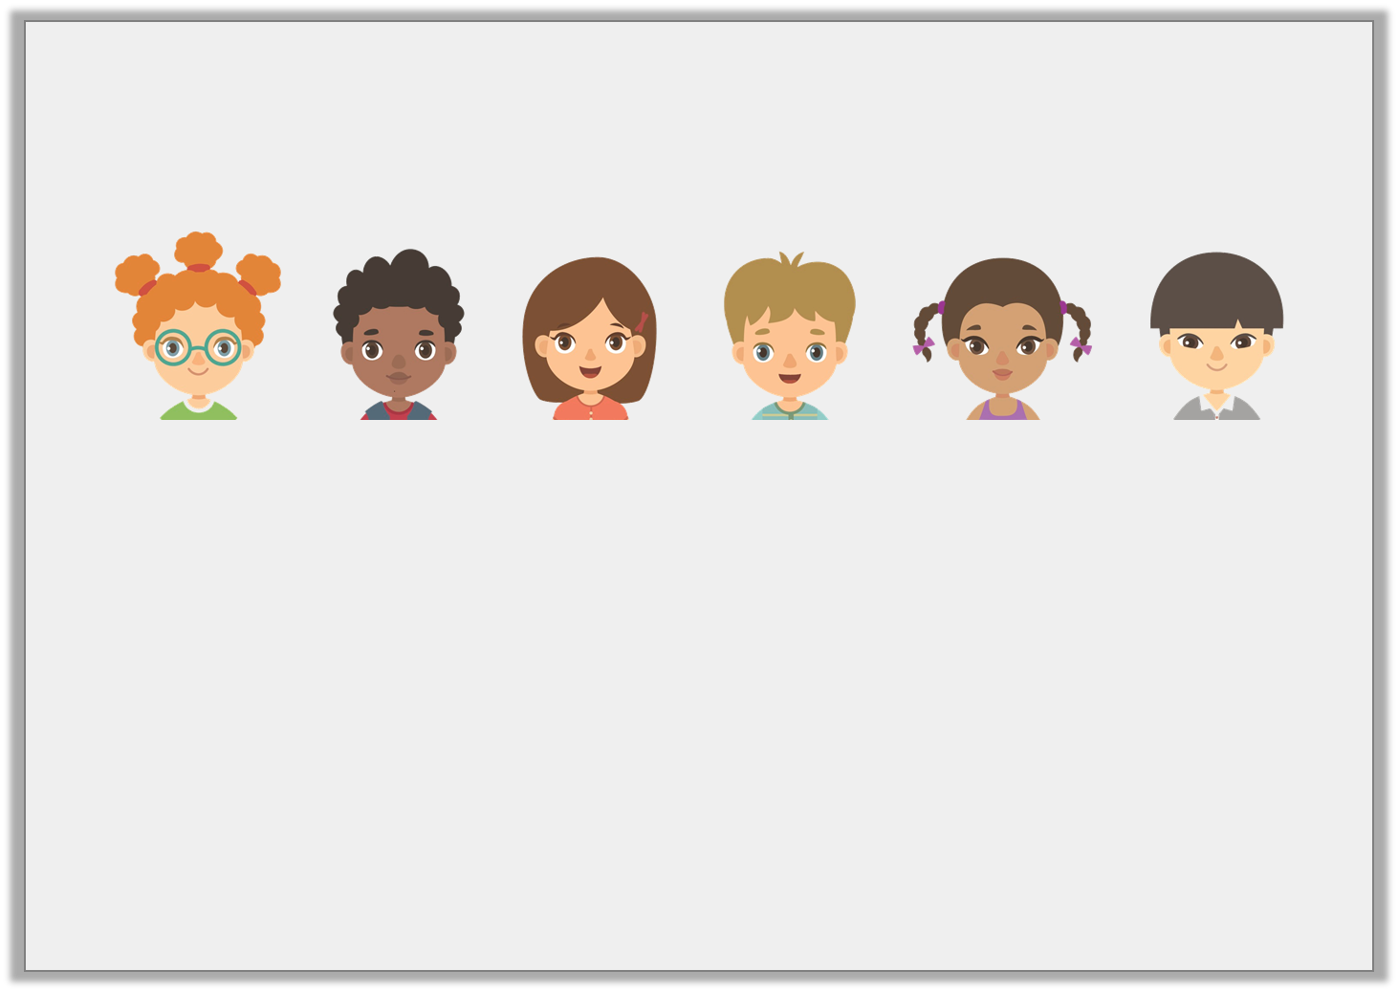
Varied Fluency 4
Six friends weigh 71.5kg, 56.3kg, 70.1kg, 66.9kg, 58.7kg and 60.5kg.
What is their mean weight?
© Classroom Secrets Limited 2018

Slide 13
Varied Fluency 4
Six friends weigh 71.5kg, 56.3kg, 70.1kg, 66.9kg, 58.7kg and 60.5kg.
What is their mean weight?
(71.5 + 56.3 + 70.1 + 66.9 + 58.7 + 60.5) ÷ 6 =
64kg
© Classroom Secrets Limited 2018

Slide 14
Problem Solving 1
Leigh knows that the mean of his cards is 18.
He spilled paint on 2 of his cards.
What could the missing numbers be?
31.1
42
7
13.6
© Classroom Secrets Limited 2018

Slide 15
Problem Solving 1
Leigh knows that the mean of his cards is 18.
He spilled paint on 2 of his cards.
What could the missing numbers be?
Accept any two numbers with a sum of 14.3, e.g. 5 and 9.3
31.1
42
5
7
13.6
9.3
© Classroom Secrets Limited 2018

Slide 16
Problem Solving 2
Four friends are trying to work out the mean of their spending money. Shauna gets £4 less than Ellie. Ellie gets £3 more than Asif. Asif gets £6 less than Max who gets £20.
What is their mean spending money?
© Classroom Secrets Limited 2018

Slide 17
Problem Solving 2
Four friends are trying to work out the mean of their spending money. Shauna gets £4 less than Ellie. Ellie gets £3 more than Asif. Asif gets £6 less than Max who gets £20.
What is their mean spending money?
£20 + £14 + £17 + £13 = £64
£64 ÷ 4 = £16
© Classroom Secrets Limited 2018

Slide 18
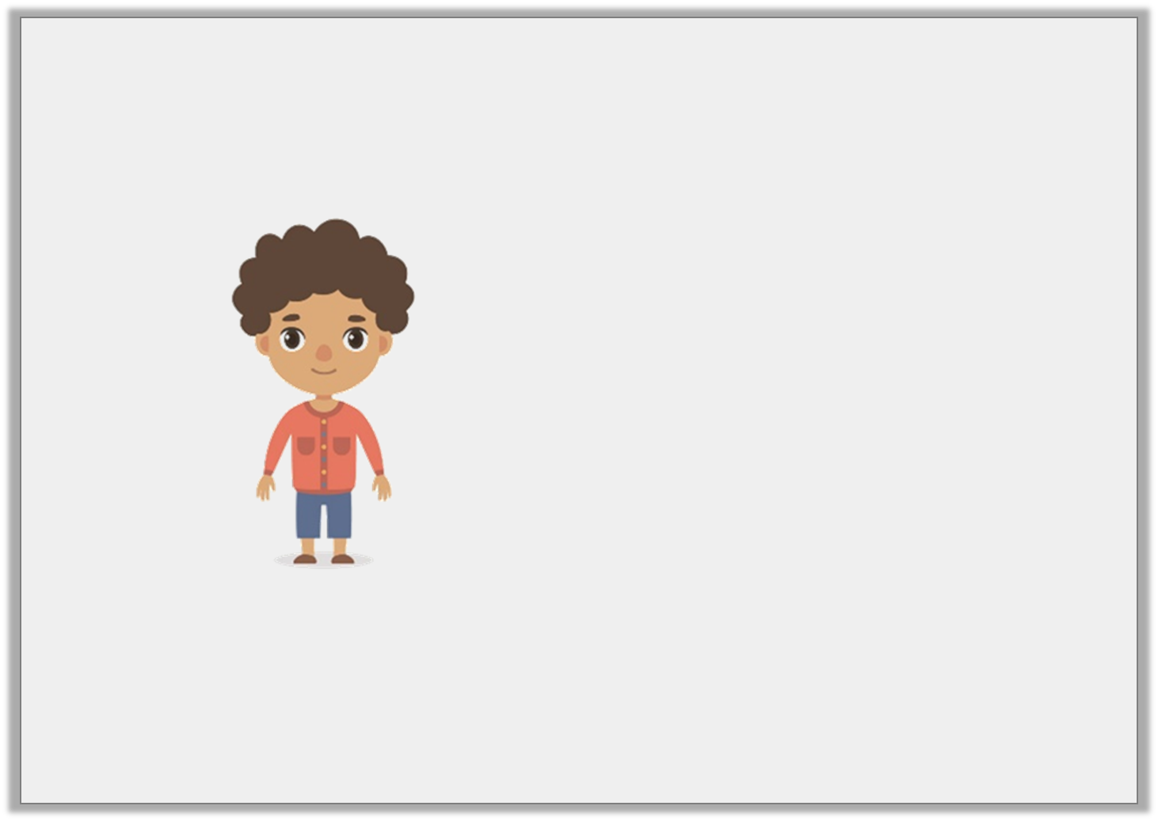
Reasoning 1
Winston is calculating the mean of five numbers:
13, 61.4, 23.6, 19 and 3.
Do you agree with Winston? Why?
To work out the mean, I found the sum of the four largest numbers and then divided them by the small number.
© Classroom Secrets Limited 2018

Slide 19
Reasoning 1
Winston is calculating the mean of five numbers:
13, 61.4, 23.6, 19 and 3.
Do you agree with Winston? Why?
Winston is incorrect because…
To work out the mean, I found the sum of the four largest numbers and then divided them by the small number.
© Classroom Secrets Limited 2018

Slide 20
Reasoning 1
Winston is calculating the mean of five numbers:
13, 61.4, 23.6, 19 and 3.
Do you agree with Winston? Why?
Winston is incorrect because to calculate the mean, you must find the sum of all the numbers and then divide by the amount of numbers.
To work out the mean, I found the sum of the four largest numbers and then divided them by the small number.
© Classroom Secrets Limited 2018

